Slide 1
Federal transit administration 5310 Funds
Call for Projects and overview
Reema Abi-Akar, Human Service Transportation Plan Regional Coordinator
August 24, 2021

Slide 2
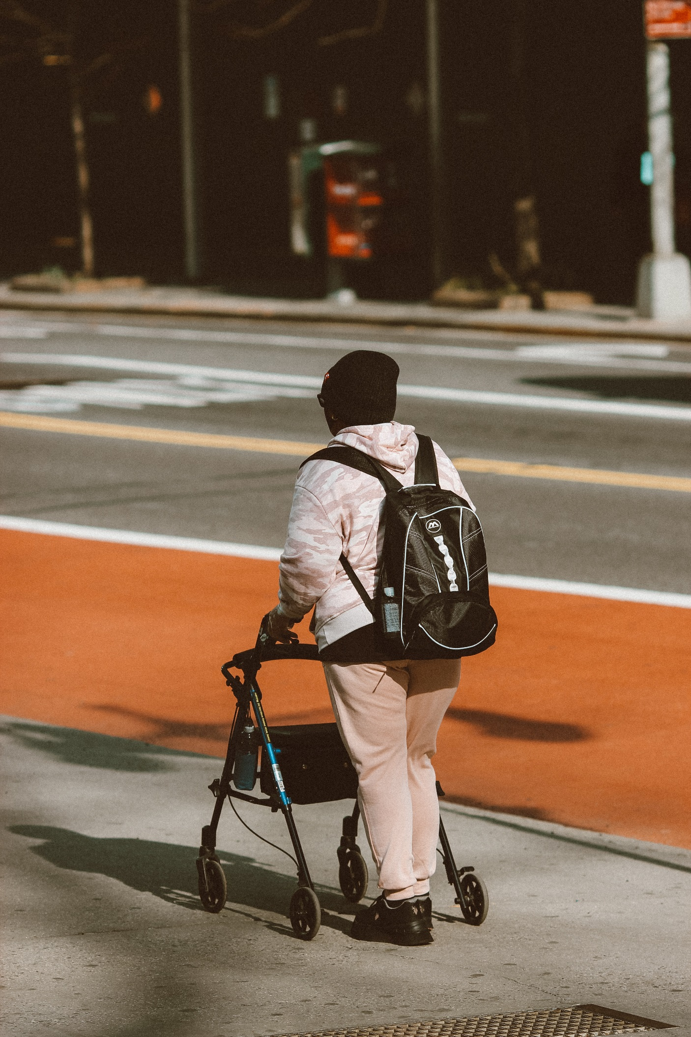
overview
Section 5310 basics
Program goals
Eligible recipients
Funding availability
Local match requirements
Eligible activities
Application and selection process

Slide 3
Basics of Section 5310
Annual urban allocation
FTA
Split allocation, 55/45
Subrecipient
IDOT
Individual projects
Projects should result in increased mobility for seniors and people with disabilities.
Subrecipient
TCRPC
Subrecipient
FTA = Federal Transit Administration
IDOT = Illinois Department of Transportation
TCRPC = Tri-County Regional Planning Commission
Notes:
TCRPC receives these funds because we have over 200,000 people in our metropolitan area

Slide 4
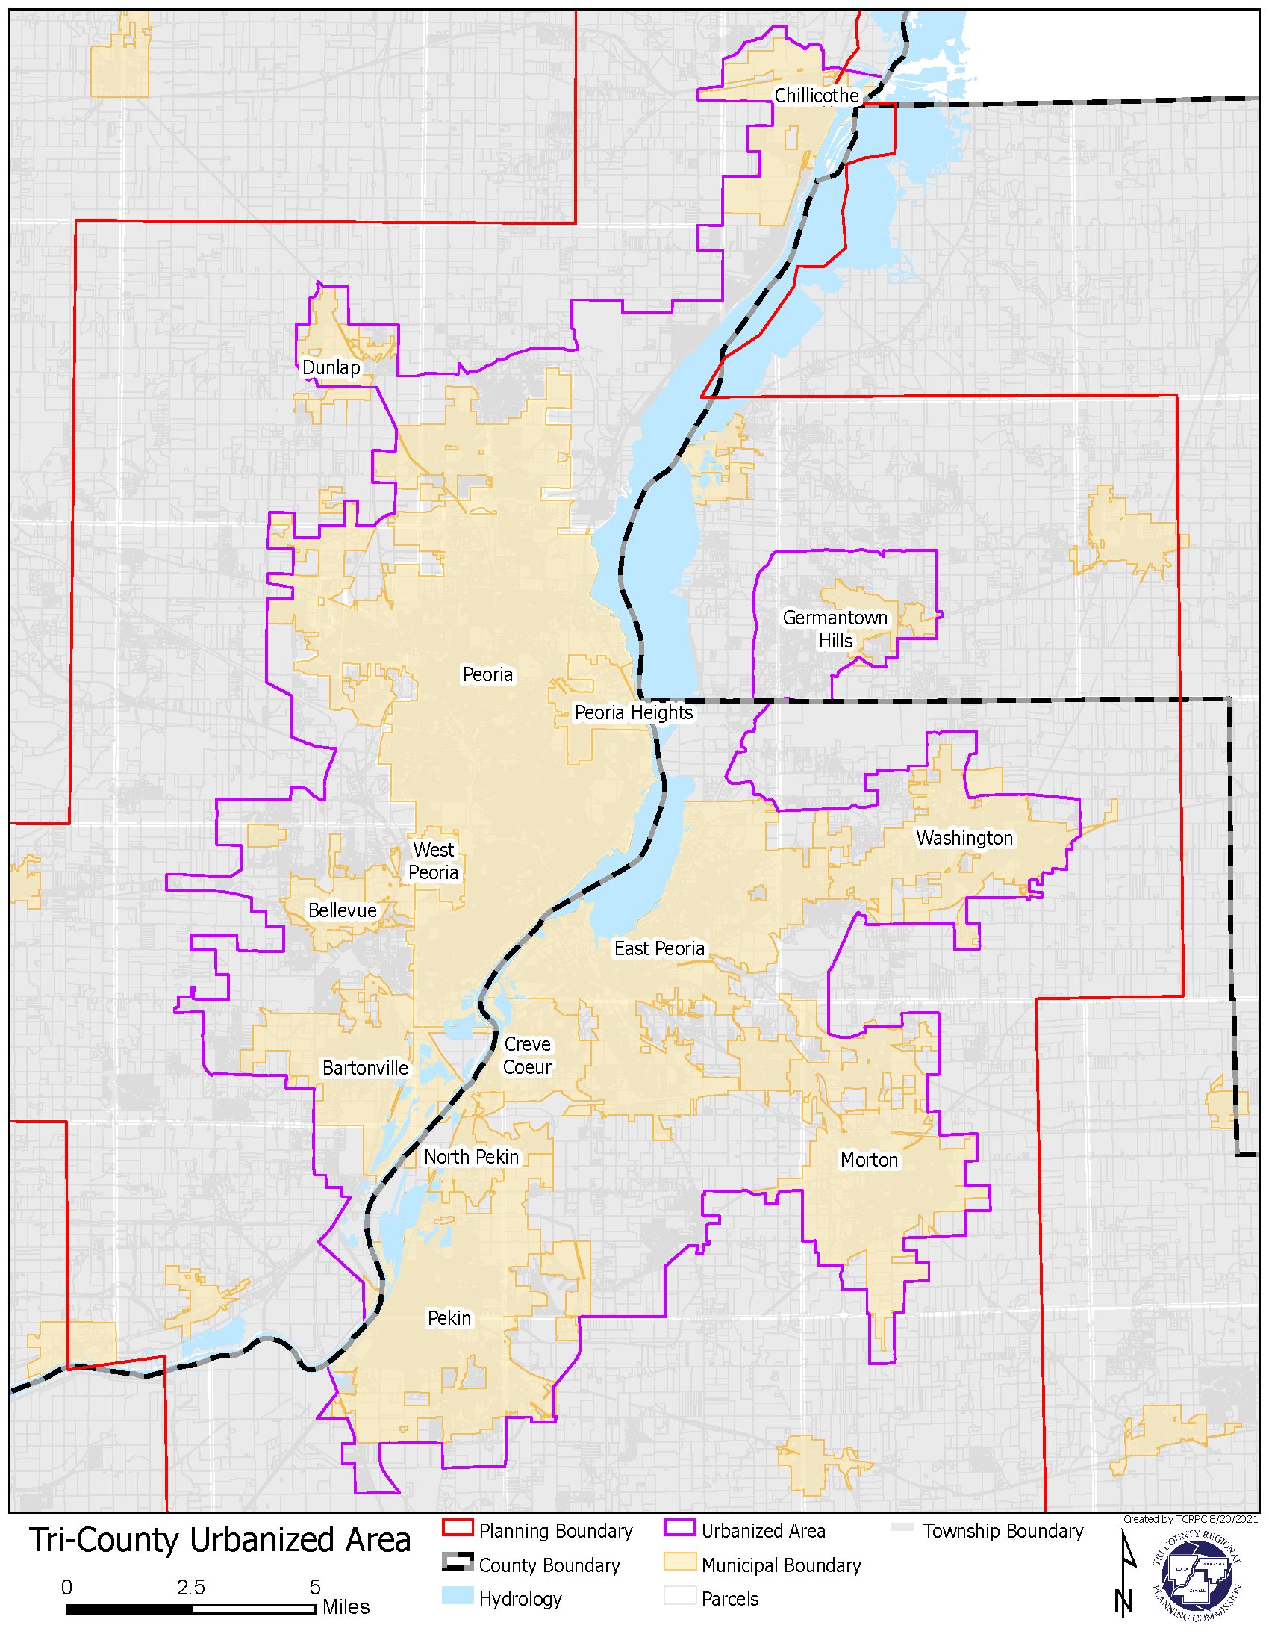
Urbanized area
Purple line = Peoria urbanized area
Yellow shading = Municipal boundaries

Slide 5
Program goal
Targeted populations:
To assist communities in meeting the transportation needs of individuals with disabilities and older adults when the transportation service already provided is unavailable, insufficient, or inappropriate to meeting those needs.
Individuals with disabilities
Seniors
Increase mobility through transit

Slide 6
Eligible recipients
Government agencies
Public transit providers
Nonprofits
Must be within Peoria urbanized area

Slide 7
Funding amounts
FY2020 funds
FY2021 funds
Up to $316,461.85 available
ARP funding
CRRSAA funding
FTA Urban apportionments
to Peoria
COVID relief funding (2021)
ARP = American Rescue Plan Act of 2021
CRRSAA = Coronavirus Response and Relief Supplemental Appropriations Act of 2021

Slide 8
Local match requirements
Capital Projects
80% federal cost share
Operational Projects
50% federal cost share
50% local share
20% local cost share
* ARP & CRRSAA do not have a local cost share requirement

Slide 9
eligible activities: Capital projects
Radios or other communication equipment
Computer hardware and software
Transit-related intelligent transportation systems (ITS)
Wheelchair restraints
Wheelchair lifts
Benches, shelters, and other passenger amenities
Wayfinding and signage
Dispatch systems
Note: Requested funds for vehicles should go through IDOT’s Consolidated Vehicle Procurement (CVP) program
80% federal
20% local

Slide 10
eligible activities: Capital projects
Mobility Management (i.e., employee hours)
Promotion, enhancement, & facilitation of access to transportation services
Support for short-term management activities to plan and implement coordinated services
Development and operation of one-stop transportation traveler call centers
Operational planning for:
Geographic information systems (GIS) mapping
Coordinated vehicle scheduling
Dispatching and monitoring technologies
Funding to support the administrative costs of:
Sharing services provided to clients
The coordinated usage of vehicles with other nonprofits
80% federal
20% local
The Grey Area study was a mobility management project!

Slide 11
Eligible activities: Operational
Expansion of paratransit service parameters beyond the three-fourths mile required by the ADA
Expansion of current paratransit hours of operation
Incremental cost of providing same-day service
Incremental cost of making door-to-door service available to all eligible ADA paratransit riders
Providing escorts or assisting riders through the door of their destination
Expenses related to voucher programs for transportation services offered by human service providers
Mileage reimbursement as part of a volunteer driver program
Support for volunteer driver programs
50% federal
50% local

Slide 12
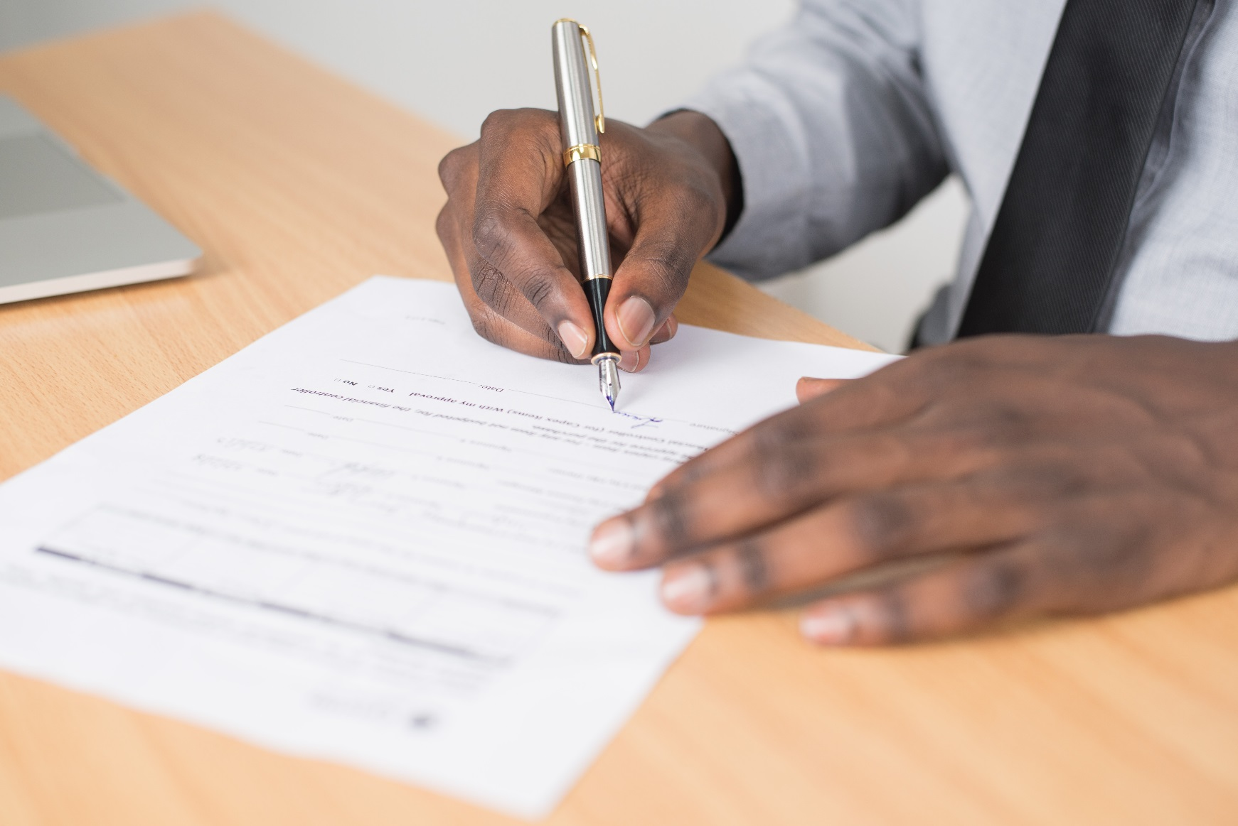
Application process
Application
Fill out through Microsoft Word
Follow instructions on pg. 4
Due on Oct. 1, 2021, by 4:00 p.m.
Utilize HSTP plan goals as guidance
Note: Reema will be out of the office Sep. 15-Oct. 1
Direct all questions/comments to Michael or Gabriel during that time

Slide 13
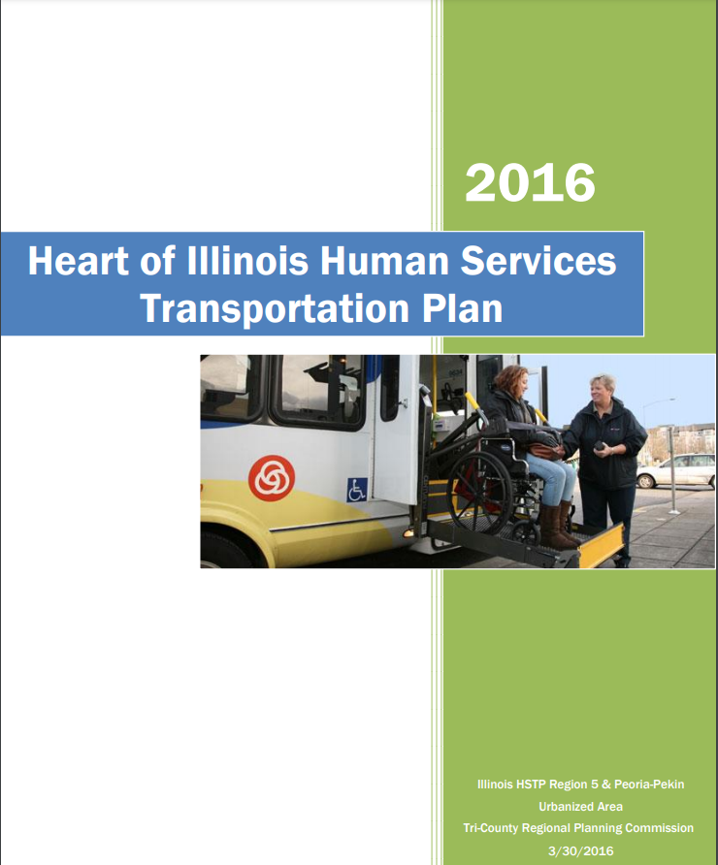
Hstp goals, from 2016 hstp DOCUMENT
Overarching goal:
HSTP Region 5 residents and employees will have the ability to autonomously participate in all aspects of life through access to safe, efficient, affordable, and quality transportation services.
Four main goals:
Increase awareness of public and human services transportation for target populations and the general public.
Improve the quality of public and human services transportation for target populations and the general public.
Increase efficiency and decrease costs of the existing transportation system.
Increase availability and options of public and human services transportation for target populations and the general public.

Slide 14
Evaluation criteria
Eligible/ineligible screening criteria
Project meets unmet transportation needs
Application addresses HSTP goals
Evaluation criteria | Maximum points
Applicant’s participation in local coordination process | 20
Applicant identifies local funding sources | 10
Project increases mobility options | 20
Project operational within a reasonable timeframe | 10
Estimated number of new customers | 25
Total | 85

Slide 15
Selection process
Call for projects: Aug. 16
Call for projects deadline: Oct. 1
Review/grade eligible projects
TCRPC applies for funding through FTA
TCRPC technical and policy boards approve projects
TCRPC staff will grade projects
Review with HSTP Urban subcommittee
Priority & consideration of lower cost share given to projects in the Grey Area

Slide 16
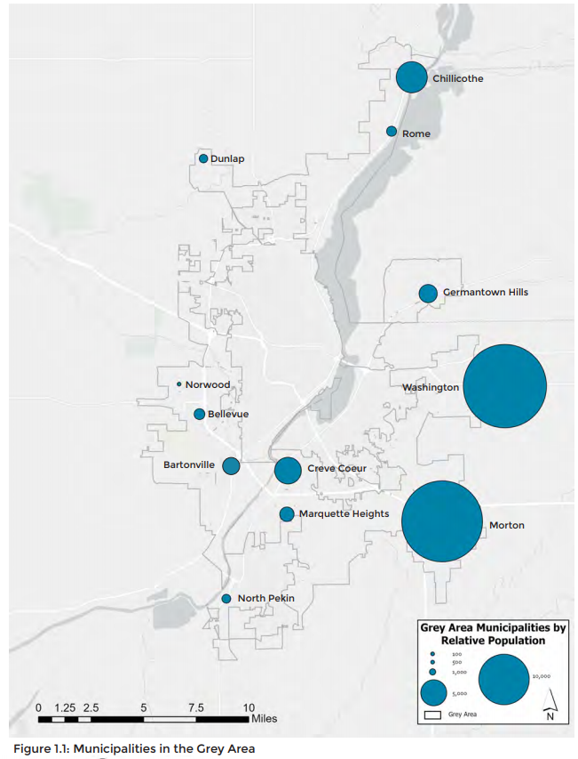
Grey area municipalities
Peoria County | Tazewell County | Woodford County
Norwood | North Pekin | Germantown Hills
Dunlap | Marquette Heights
Rome | Creve Coeur
Bellevue | Morton
Chillicothe | Washington
Bartonville
The Grey Area also includes the urbanized unincorporated sections of each county

Slide 17
Post-award: Subgrantee reporting requirements
Monthly financial & brief status reports
May require more admin work depending on project
i.e., capital projects would require environmental reviews and following procurement policies of your agency & FTA

Slide 18
Thank you!
Contacts:
Reema Abi-Akar
rabiakar@tricountyrpc.org
309-673-9330
Gabriel Guevara
gguevara@tricountyrpc.org
309-673-9330
Michael Bruner
mbruner@tricountyrpc.org
309-673-9330
Visit our website: https://tricountyrpc.org/transit/

